Slide 1


Unit 2: Lesson 7 What a day

Slide 2
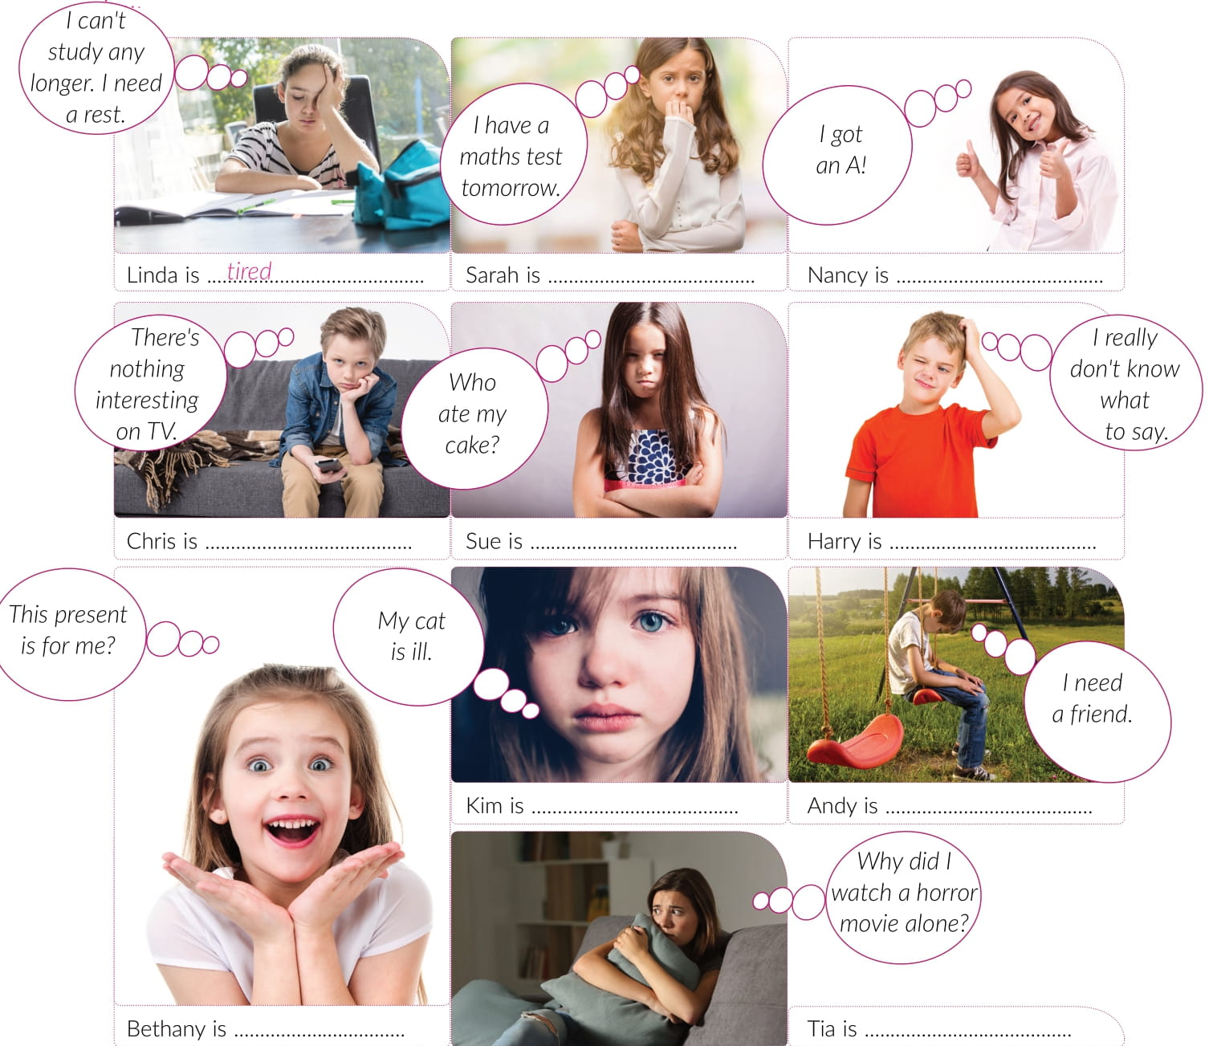
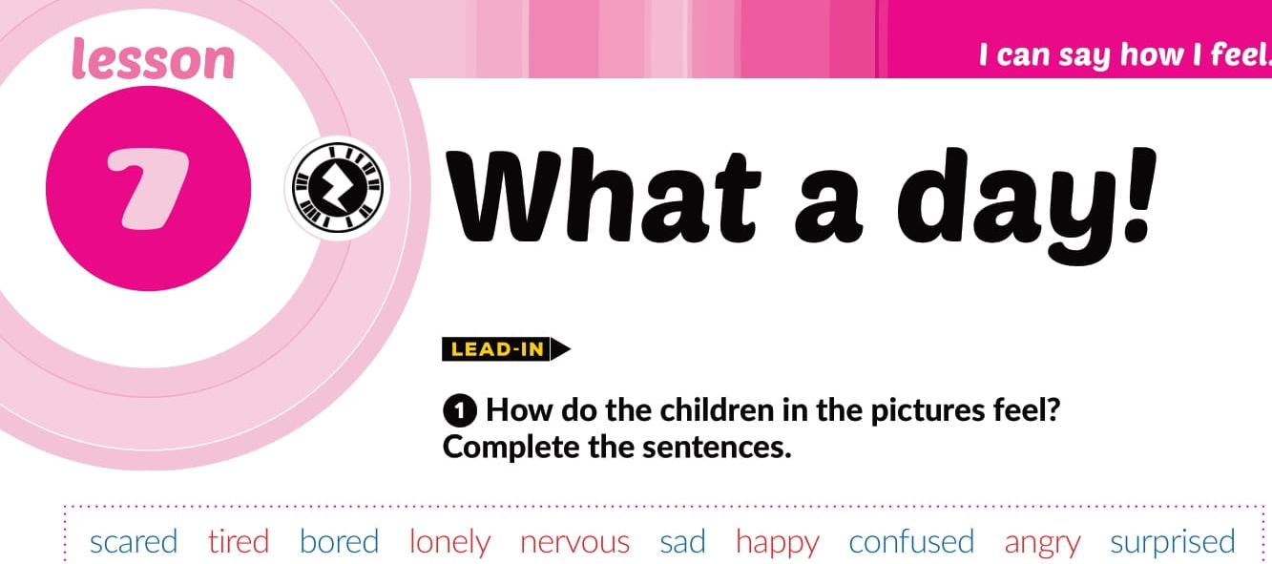
nervous
happy
bored
angry
confused
sad
lonely
surprised
scared

Slide 3
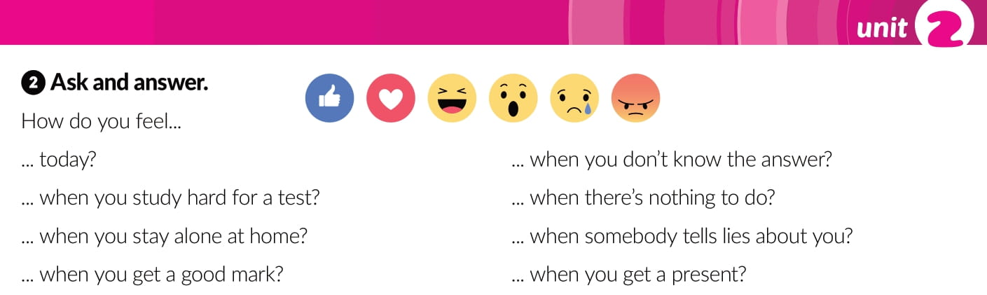

Slide 4
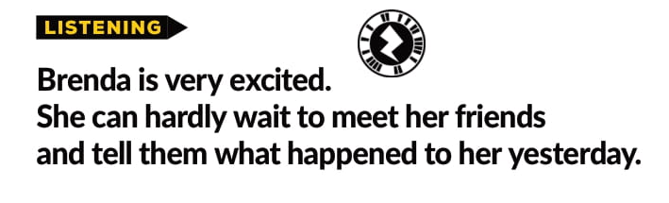
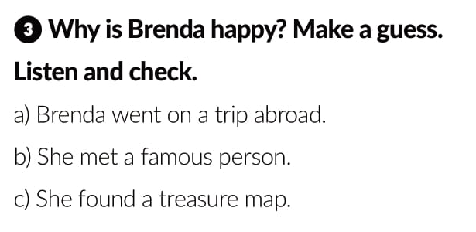
https://www.e-sfera.hr/dodatni-digitalni-sadrzaji/54c3d7fb-f9c4-4c69-9c8b-889e6f7925ec/

Slide 5
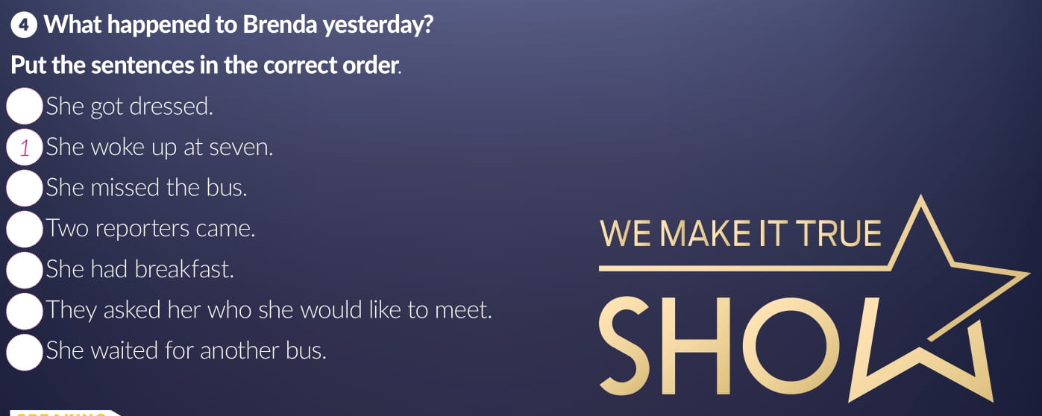
2
4
6
3
7
5

Slide 6
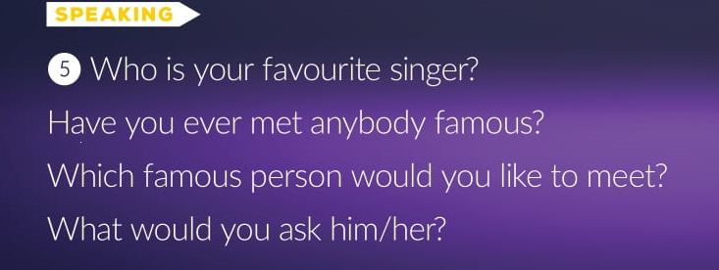

Slide 7
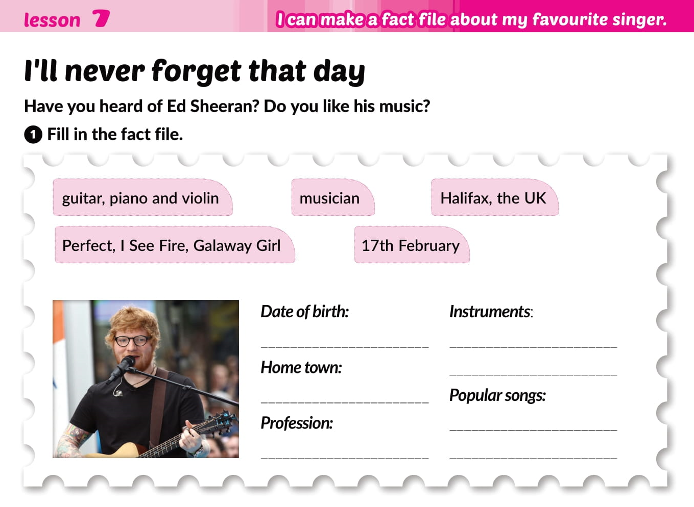
17th February
guitar, piano and volin
Halifax, the UK
Perfect, I see fire, Gallaway Girl
musician

Slide 8
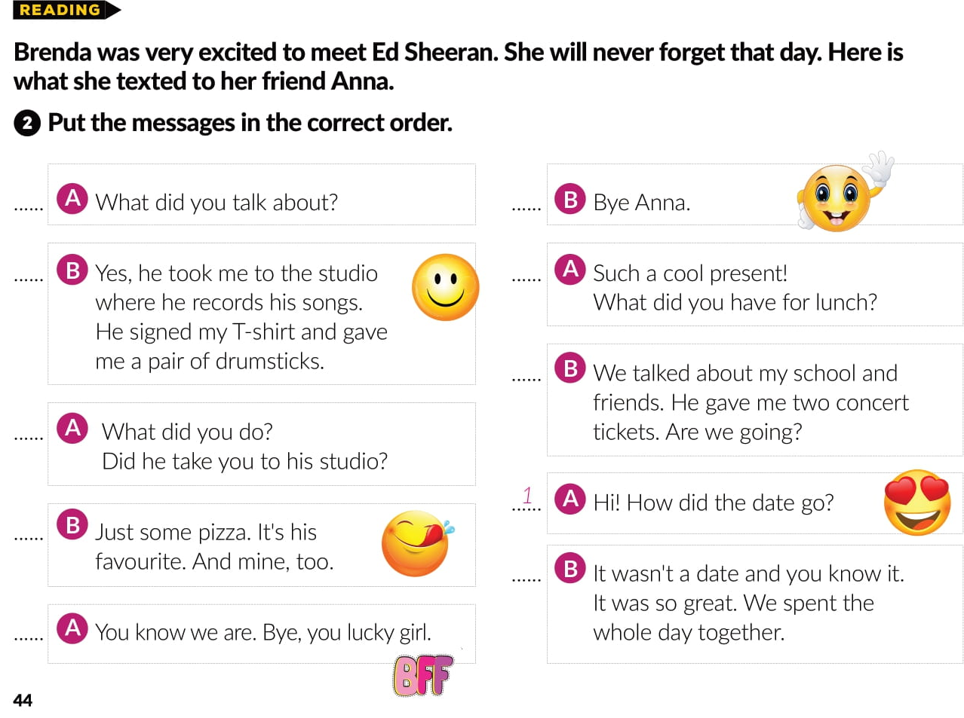
7
10
4
5
8
3
6
2
9

Slide 9
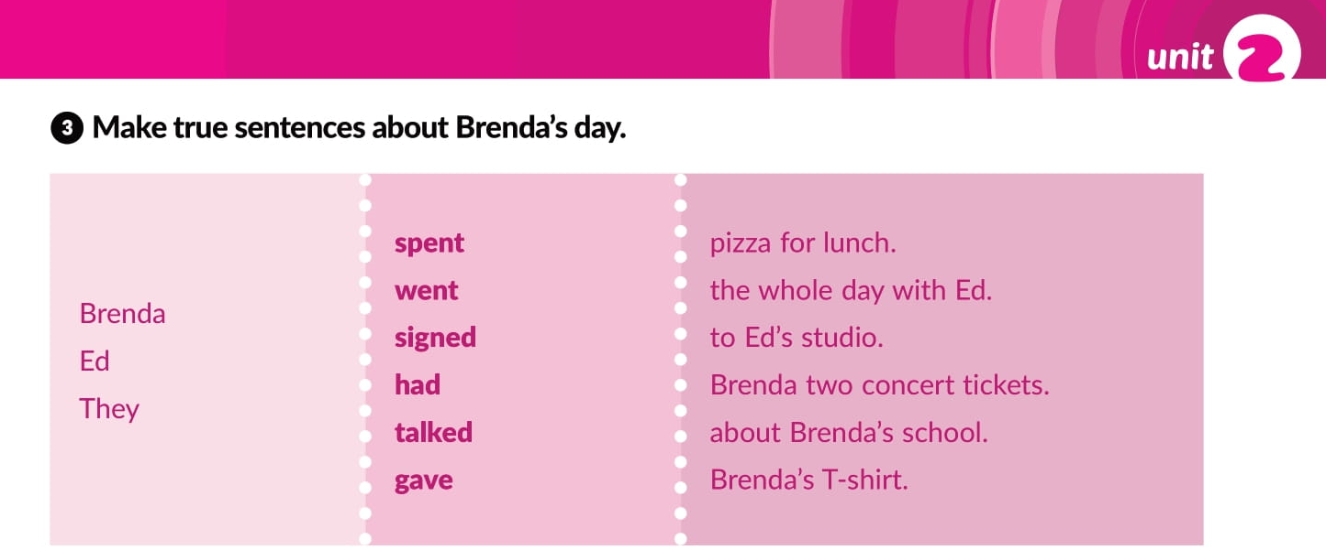

Slide 10

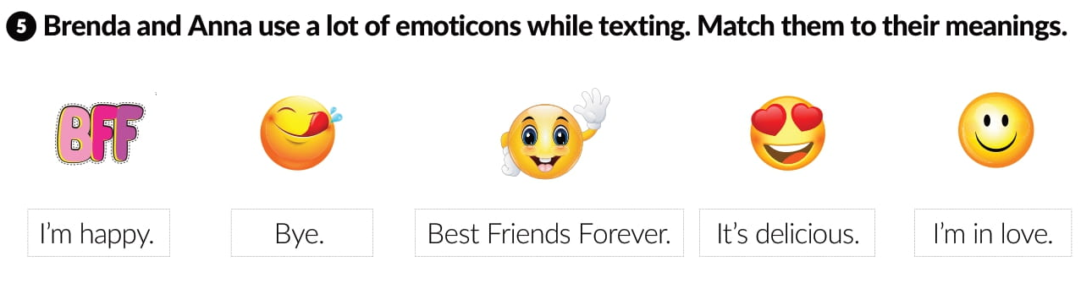
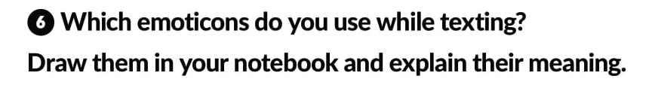
Best Friends Forever.
It’s delicious.
Bye.
I’m in love.
I’m happy.

Slide 11
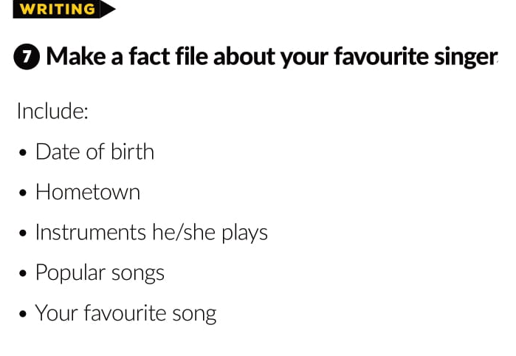

Slide 12
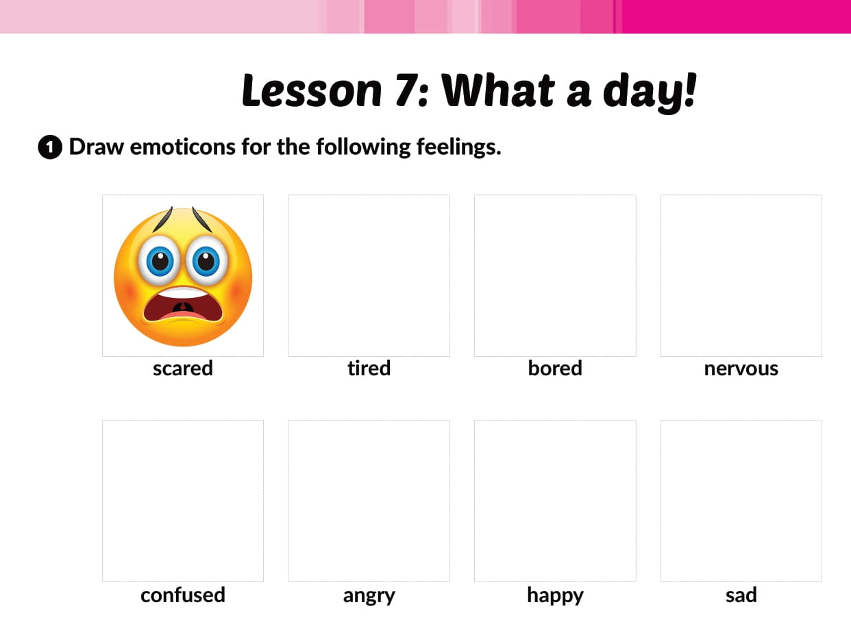




Workbook p. 30.
😪
😔
😠

Slide 13
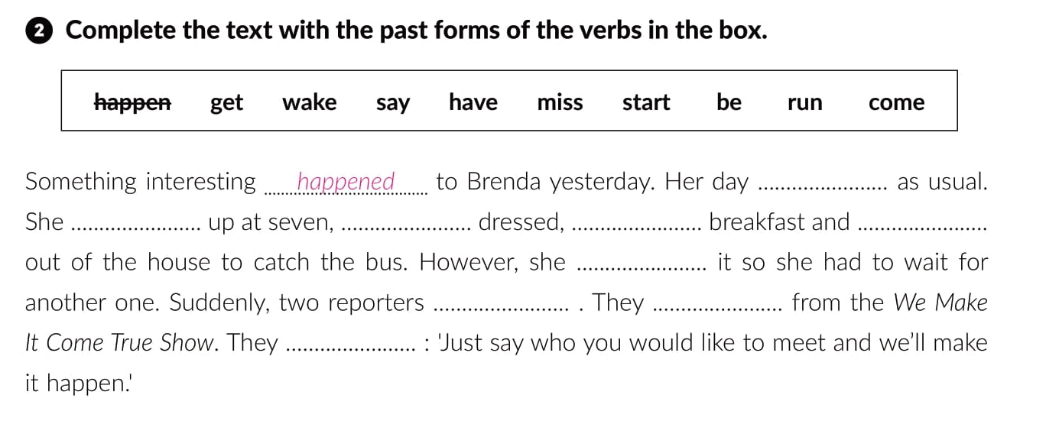
started
woke
got
had
ran
missed
came
were
said

Slide 14
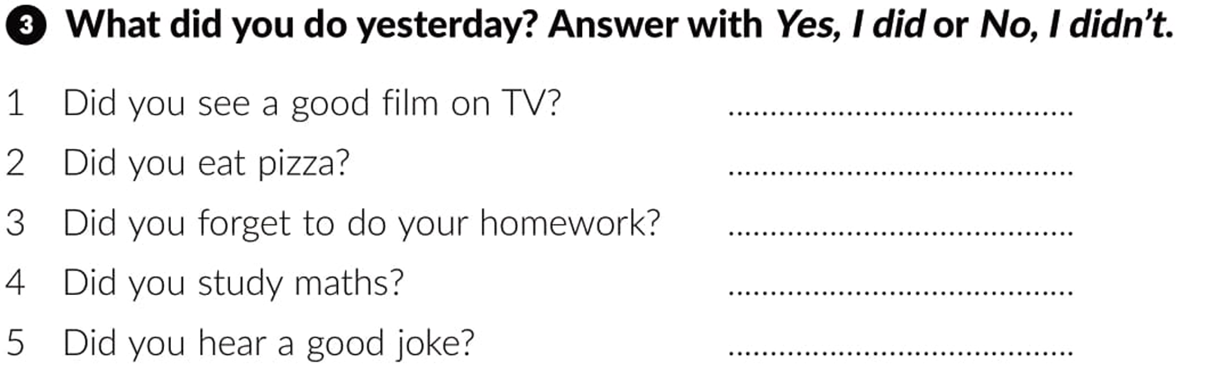
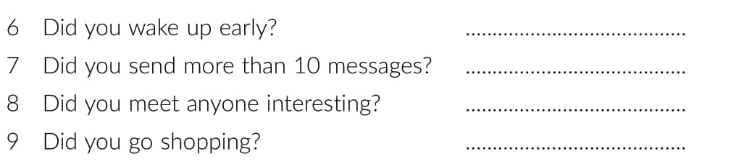

Slide 15
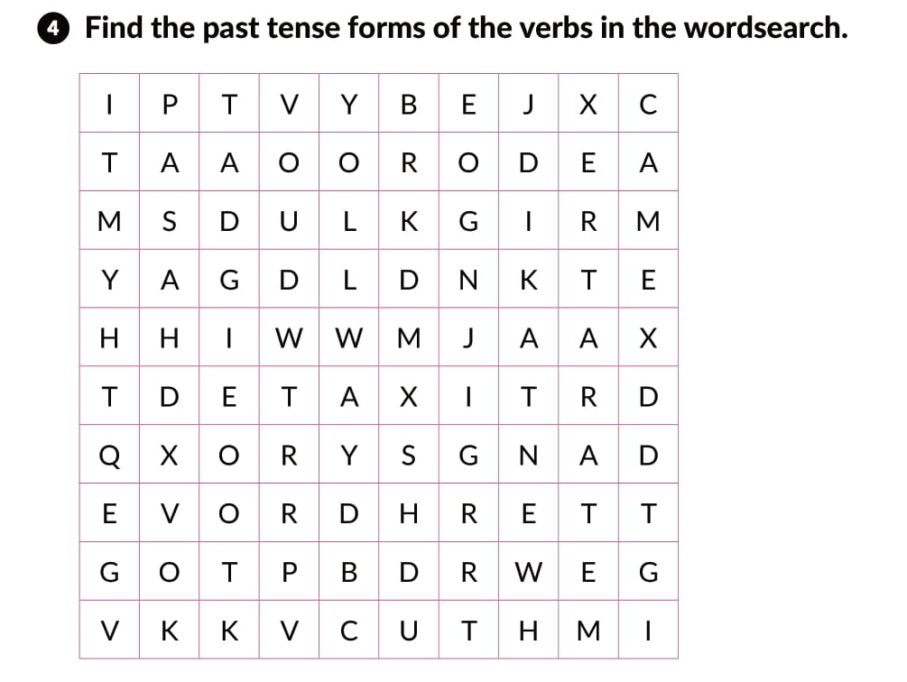
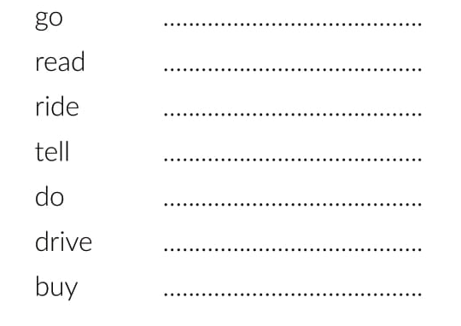
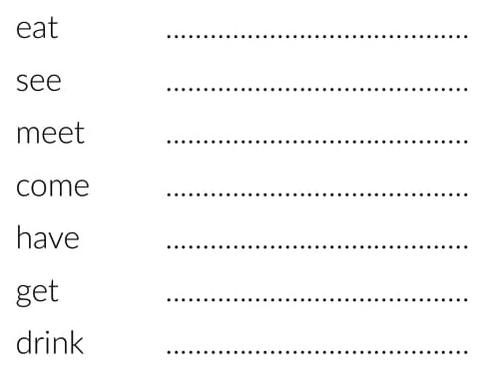
went
read
rode
told
did
drove
bought
ate
saw
met
came
had
got
drank

Slide 16
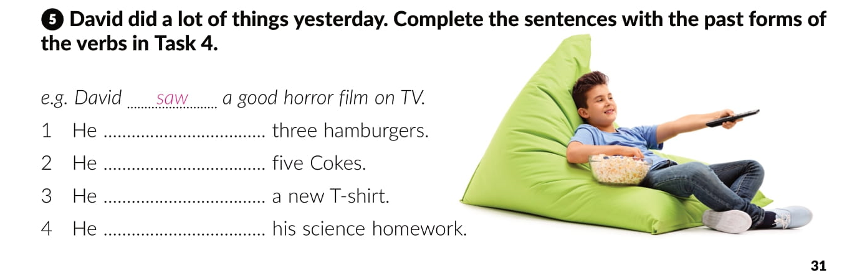
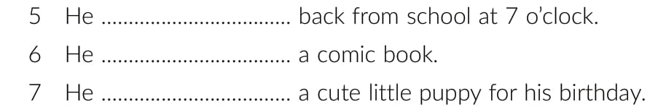
ate
drank
bought
did
came
read
got

Slide 17
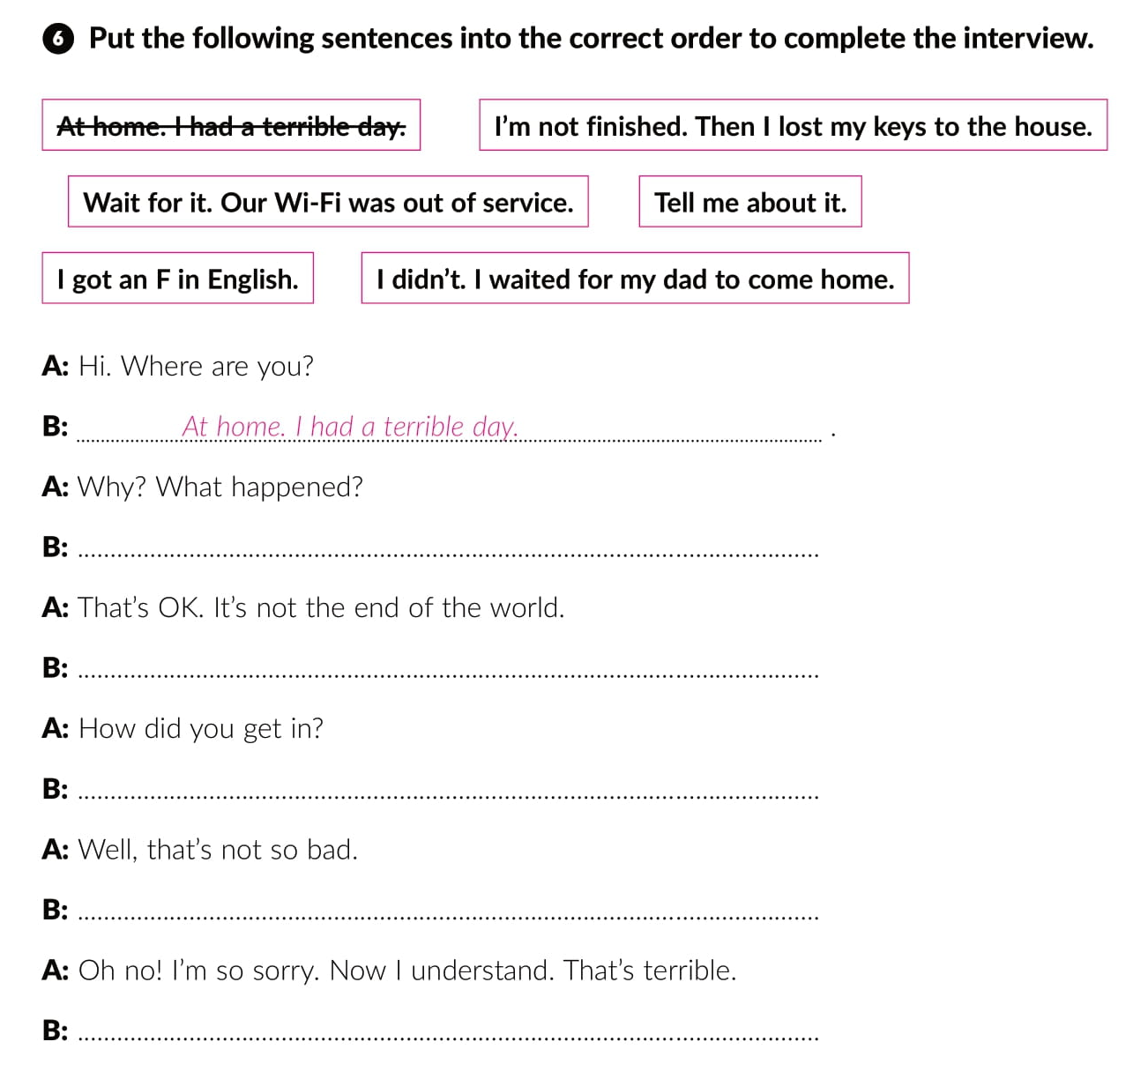
I got an F in English.
I’m not finished. Then I lost my keys to the house.
I didn’t. I waited for my dad to come home.
Wait for it. Our Wi-Fi was out of service.
Tell me about it.

Slide 18
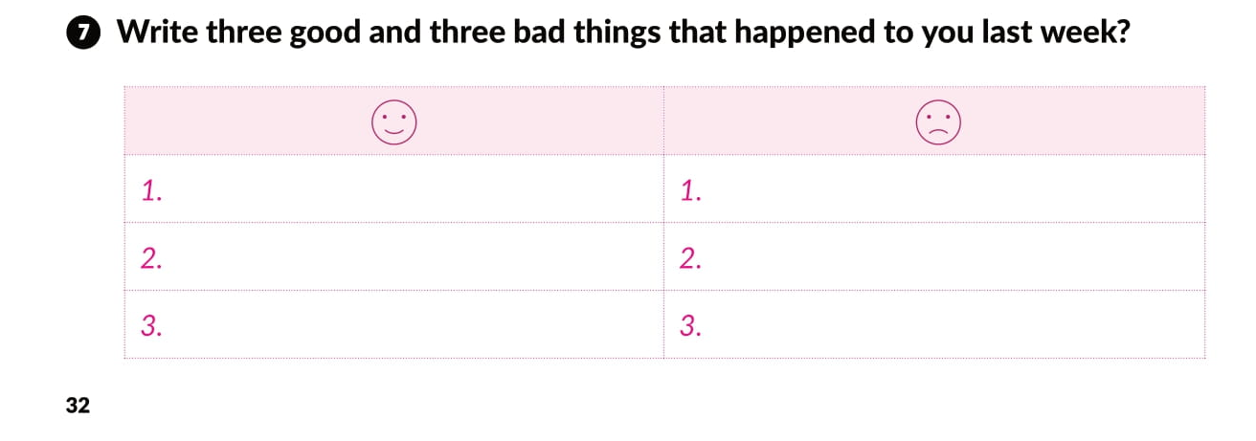

Slide 19

PLAY AND LEARN!
https://www.e-sfera.hr/dodatni-digitalni-sadrzaji/54c3d7fb-f9c4-4c69-9c8b-889e6f7925ec/

